Slide 1

INGLÉS PARA EL TRABAJO
Tema 12: Past Simple with Regular and Irregular Verbs.
Todas las carreras.

Slide 2
Redacta oraciones y preguntas en pasado utilizando los verbos regulares e irregulares en inglés.

Slide 3
TEMA 12: Past Simple with Regular and Irregular Verbs.
SUBTEMAS:
Past Simple with Regular and Irregular Verbs in all forms.

Slide 4
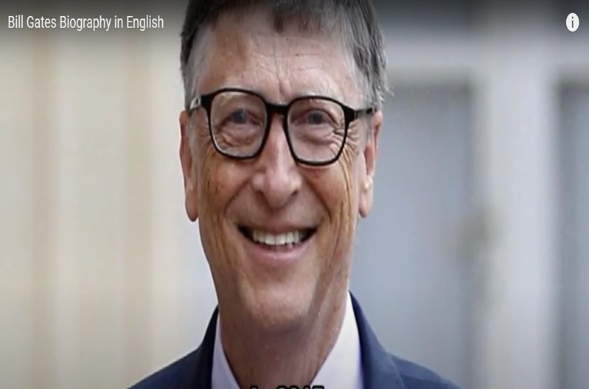
Inglés para el Trabajo
Past Simple with Regular and Irregular Verbs
Watch the video and say if these sentences are True or False.
1.He was born in 1955 in France. __
2.When he was 13, he wrote his first sotware program. ___
3.He studied in Hardvard College. ___
4.He was interesed in computers more than in other subjects.___
4.Bill Gates and his friend Paul Allen collaborated to found Microsoft in 1975.___
5.In 2016,Gates and his wife received a Medal of Freedom. ___
https://www.youtube.com/watch?v=zZnuig6x0eo

Slide 5


Inglés para el Trabajo
Past Simple with Regular and Irregular Verbs
When we talk about past actions we use regular and irregular verbs.
PAST SIMPLE

Slide 6
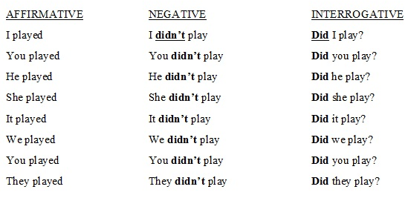
Inglés para el Trabajo
Past Simple with Regular and Irregular Verbs
When we talk about past actions we use Past Simple in these forms:

Slide 7
Virtual Activity

Slide 8
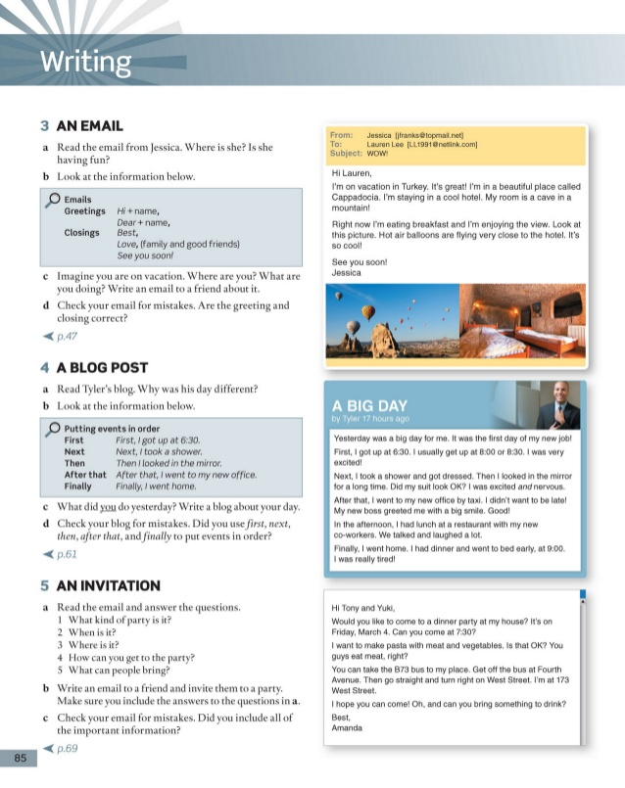
Inglés para el Trabajo
Virtual Activity
Read and complete the Tyler’s blog with the correct verb in parentheses.
Yesterday was a big day for me .It was the first day of my new job!
First,I (get)………. up at 6.30 p.m.I usually get up at 8 .00 .I (be)…….. very excited!
Next,I (take)…….…. a shower an got dressed .Then I looked in the mirror for a long time .Did my suit look OK? I was really nervous.
After that,I went to my new offfice by taxi. I didn’t( want)………... to be late ! My new boss greeted me with a long smile. Great!
In the afternoon I (have)…….… lunch at the restaurant with my new co-workers. We (talk)………….. and laughed a lot.
Finally ,I went home .I had dinner and (go)………… to bed early at 9.00.I was very tired!

Slide 9
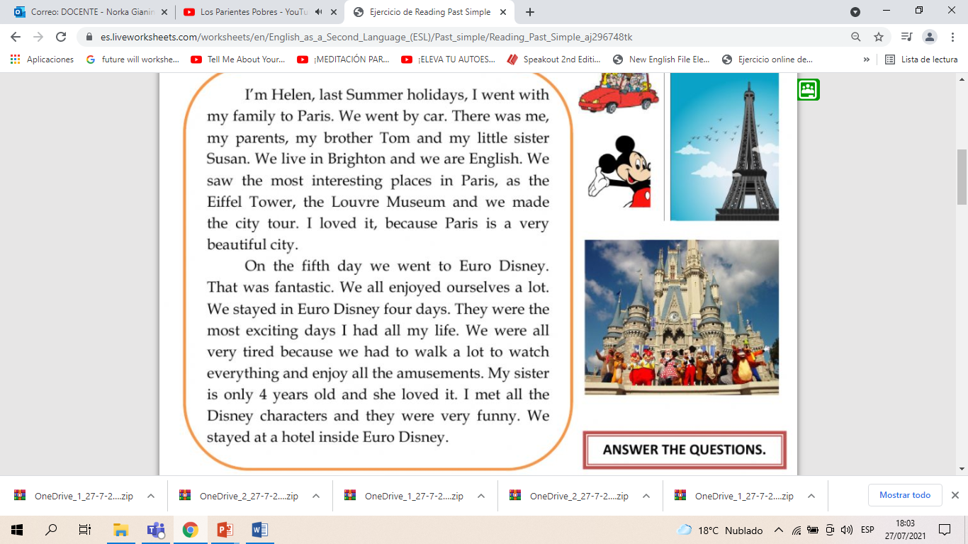

Inglés para el Trabajo
Virtual Activity
Read and answer the questions.

Slide 10
Inglés para el Trabajo
Virtual Activity
Now, answer the questions.
1.Did Helen go travel with her family?
2.Did she like Paris?
3.What did they see in Paris?
4.Where did they go on the fifth day?
5.Did they enjoy it?

Slide 11
Thanks!

